Slide 1
Stress Recognition
A shanker method©
practice
Notes:
Recognizing Stress and Stressors is one of the 5 practices in the Shanker Framework;
The Shanker Framework© includes the domains from which these stressors emanate, as well as the Practices in which we engage to understand the energy/tension levels impacting peoples’ daily interactions and their ability to perform tasks.

Slide 2
Acknowledgement
Some of the slides and/or content contained in this presentation is being shared with the permission of Dr. Susan Hopkins & The MEHRIT Ctr. (self-reg.ca)
Permission has been granted for use in presentations by students or graduates of The Shanker Method, Self-Reg Level 2 Facilitators training program.

Slide 3
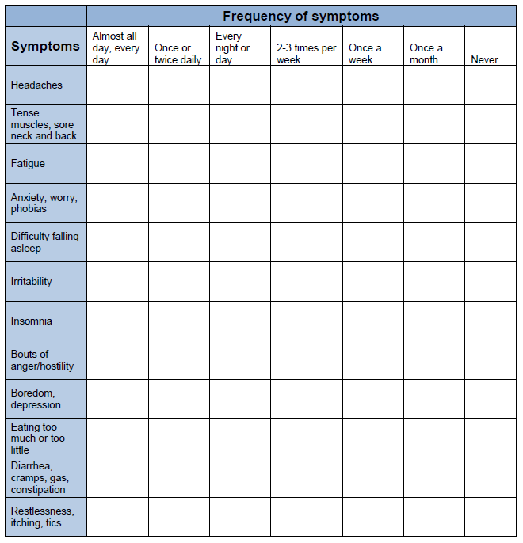
A Symptom Inventory
https://www.nysut.org/~/media/files/nysut/resources/2013/april/social-services/socialservices_stressassessments.pdf?la=en
Notes:
One of the Practices in the Shanker Framework is that of Detecting Stress. (As I will explain in just a few slides).
Stress is a necessary part of our lives and can have both beneficial and negative effects. A stress response is primarily determined by our perception of an event, transition, or problem.
An important first step is recognizing the degree to which we ourselves are affected by the stress in our lives.
This self-assessment checklist from New York State United Teachers (NYSUT) can help us determine the degree and type of stress we are experiencing and how its impact is manifest.
Please keep in mind that as a self-completed questionnaire it is subject to our own biases and is not intended to provide a diagnoses of any kind.
How frequently do you find yourself experiencing such problems as headaches, problems going to sleep or staying asleep, unexplained muscle pain, jaw pain, uncontrolled anger, and frustration? Using the table below, assess the frequency that you experience these common symptoms of stress.

Slide 4
Our Objectives today
Situate the Recognizing Stress practice within the Shanker Framework©
Re-define Stress
Cues to prompt Stress Recognition
Notes:
This presentation includes a simple overview of that Framework, a reminder of the definition of Stress, and some cues to recognizing stress in yourself, and others.
Let me remind you what is Self-Reg all about.
Shanker Self-Reg® is a process for enhancing self-regulation by understanding and dealing with stress. In Self-Reg we consider both our responses to stress and our underlying state of energy and tension when we encounter a stress.
There five domains from which stress originates, and five practices we employ to understand and deal with our stressors in an optimal way. These Domains & Practices together make up the Shanker Framework©.

Slide 5
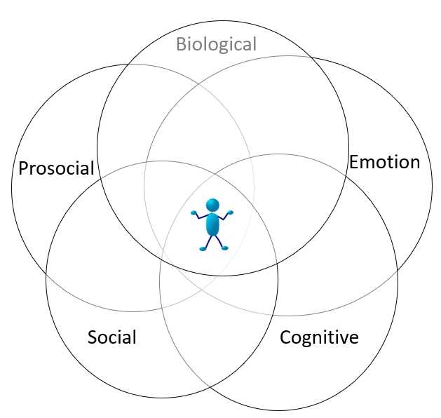
The Shanker Framework©
Practices
Read & Reframe the Behaviour
Recognize the Stressors
Reduce the Stressors
Reflect on Stress Awareness
Respond to Restore
Domains
Notes:
The Practices include: Read & Reframe the Behaviour, Recognize the Stressors, Reduce Stressors, Reflect On & Enhance Stress Awareness, and Respond with Personalized Practices to Restore and Support Resilience. These are not necessarily sequential or hierarchical as steps but are each an important part of the overall puzzle. Think of it as a pie cut into five equal slices.
The Domains include: Biological, Emotion, Cognitive, Social, & Prosocial. They are not as separate and distinct as one might think, and I will discuss that shortly.

Slide 6
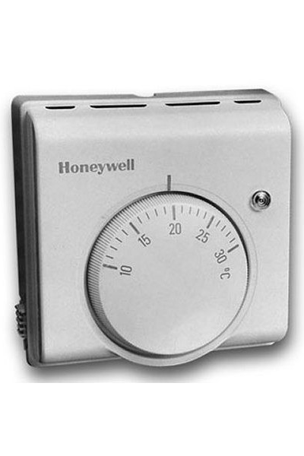
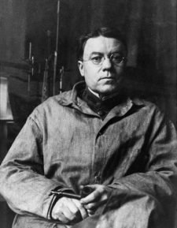
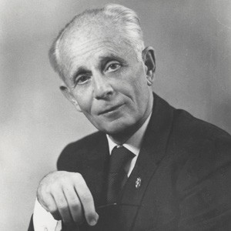
Walter Bradford Cannon (L)
Hans Selye (R)
Pioneers in stress research
Notes:
The work of Dr. Shanker builds on the foundational work done previously by Walter Bradford Cannon, and Hans Selye.
Cannon (seen on the left) a prominent American Physiologist at Harvard discovered physiological changes that occurred under various stimuli in simple organisms.
What he saw was that in an otherwise homeostatic state, they would undergo changes depending on the stimuli it was subjected to.
Hans Selye (seen here on the right) from McGill University contributed to the understanding of the human body’s response to prolonged excessive stress and the general adaptation syndrome from alarm, through resistance, on through to exhaustion.
The metaphor of a Thermostat and Furnace are helpful in conceptualizing this interplay.
We set the thermostat at a particular temperature, monitor that homeostatic temperature, and either turn the furnace on or off as needed.
Our brain’s hypothalamus is largely responsible for control of, and triggering the release of hormones in response to environmental stimuli in much the same way the thermostat turns the furnace on/off depending on whether or not heat is needed. When your hypothalamus senses a change in your body, it will tell the right gland how to help correct that change.
Really what it comes down to, is defining Stress as anything that moves one away from Homeostasis.

Slide 7
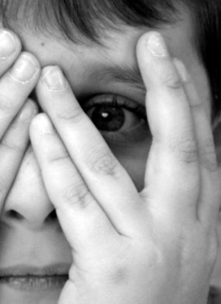
States of Arousal
Asleep
Drowsy
Calm, Focused Alert
Hypo-aroused
Hyper-aroused
Flooded
Notes:
The reality of it is however, we experience many of these homeostatic changes each and every day.
We move through these various states of arousal with varied levels of energy to expend (or not) at our disposal several times a day.
There are stressors that recovery from, requires the expenditure of energy. There are also restorative practices in which we engage every day to replenish our energy reserves.
You may recall the Thayer Matrix the simultaneously looks at both our stress level, and energy level continua.

Slide 8
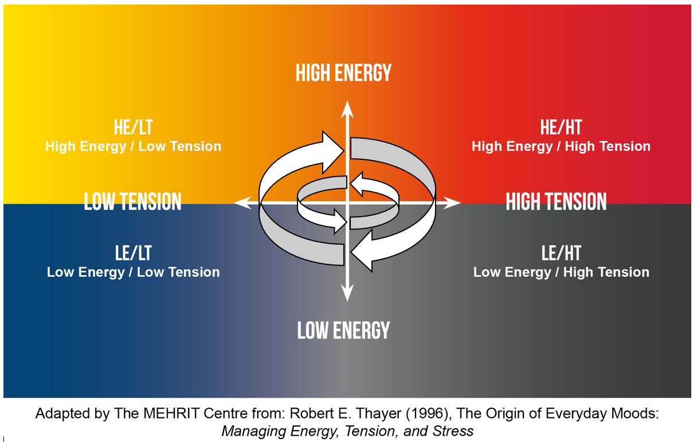
Consider both energy and tension levels in order to determine the quadrant in which an individual may be operating.
Notes:
In whichever quadrant on this matrix that we find ourselves, or potentially another individual, will determine their reactivity.
We can look at each quadrant:
Low Energy/Low Tension – could be drowsy or sleeping
High Energy/Low Tension – could be playing
High Energy/High Tension – could alert, focused, and learning
Low Energy/High Tension – could be in responding to tension in maladaptive ways.
Knowing fell-well that we move between these states several times a day.

Slide 9
Identify your energy consumers
How do the following affect you?
Lighting?
Noise?
Visual clutter?
Temperature?
Having to wait?
Junk food?
A large crowd?
Worry about appearance?
Not enough sleep?
Alcohol?
Sugar/Salt?
Allergies?
Textures?
Can you think of others?
Notes:
Less important however, is the categorization of the Domain within which these stressors can be characterized… than is the recognition of the profound impact they have on our
psycho-neuro-endcrinological well-being.
Take a few moments to think of those things that cause you distress.
Think of the ways in which that distress might be noticeable to others?

Slide 10
Potential Stressors by Domain
Biological | Emotion | Cognitive | Social | Prosocial
Noise, crowds, too much visual stimulation, not enough exercise, lack of sleep, salt, sugar, junk food, allergies, being sick, bright lights, dim lights | Strong emotions, both positive (over-excited) & negative (anger, fear) | Difficulty processing certain kinds of information, Recognizing patterns | Difficulty picking up on social cues, or understanding effect of behaviour on others | Difficulty coping with other people’s stress, empathy; sense of injustice
Notes:
There are any number, or combination of a number of stimuli that drain our energy as we try to regain our own sense of homeostasis.
Here are some to name a few in each relative Domain.
Time for some self reflection.
Take some time and identify three pervasive stressors for you in each of the five domain attachment. (Appendix 1)
https://self-reg.ca/wp-content/uploads/2020/06/1_4_Domain_Stress_Examples_V2.pdf

Slide 11
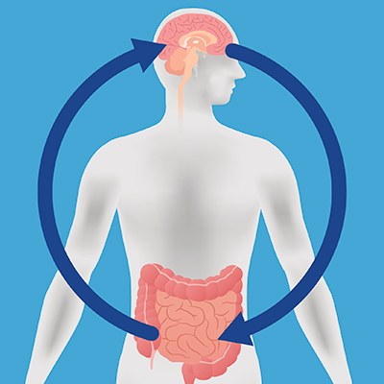
https://neuro.hms.harvard.edu/harvard-mahoney-neuroscience-institute/brain-newsletter/and-brain/gut-and-brain
Notes:
Now let’s turn our attention inward to look at what’s occurring while under that distress.
Our gastro-intestinal (GI) tract for example has its own nervous system known as the Enteric Nervous System and is often thought of as our 2nd Brain.
There exists a simultaneously an incredibly complex yet remarkably simple system of inter-related communication between the Central Nervous System and the Enteric Nervous System.
“There is immense crosstalk between these two large nerve centers,” says Braden Kuo, MD, MMSc ’04, co-executive director of the Center for Neurointestinal Health at Massachusetts General Hospital (MGH) and assistant professor of medicine at Harvard Medical School. “This crosstalk affects how we feel and perceive gastrointestinal (GI) symptoms and impacts our quality of life.”
The vagus nerve has the most extensive distribution of the cranial nerves. Its branches transmit motor impulses to
Our Cardiovascular System
Our Respiratory System
Our Ingestion & Digestion systems.
In short, it is a superhighway of information between the brain and organs. Your brain sends signals to your gut, and vice versa.
By wandering and branching throughout the body, this nerve provides the primary control for the nervous system's parasympathetic division: the rest-and-digest counterpoint to the sympathetic nervous system's fight-or-flight response.
When the body is not under stress, the vagus nerve sends commands that slow heart and breathing rates and increase digestion. In times of stress, control shifts to the sympathetic system, which produces the opposite effect.
The vagus nerve also carries sensory signals from internal organs back to the brain, enabling the brain to keep track of the organs' actions.
The enteric nervous system has all the neurotransmitters found in the brain and produces/stores 90% of the body's serotonin (in enterochromaffin cells). Not only is serotonin important for feelings of well-being, happiness and sleep, it also contributes to peristalsis. Too much can lead to diarrhea; too little can lead to constipation.

Slide 12
Brain-Body Connection is undeniable
Stress switches on…
Adrenaline elevates heart-rate, blood pressure, and respiration
Cortisol metabolizes fat from fatty cells, glucose from liver
Sweat glands open
Endorphins are released → opiate receptors
Alertness & Reactivity are enhanced
Hair stands on end
Stress switches off…
Digestion
Reproduction
Immune System
Capillaries
Cellular reparation
Muscles in middle ear constrict
Prefrontal Cortex
Notes:
Our own fight or flight response, just like fight or flight response in others (to varying degrees or AT varying degrees of distress) neuroceptively trigger certain physiological reactions.

Slide 13
The Work of a Stress Detective
Think of the ways in which you would be able to tell whether you were witnessing…
Misbehaviour or
Stress Behaviour
Notes:
Let’s brainstorm some ideas:

Slide 14
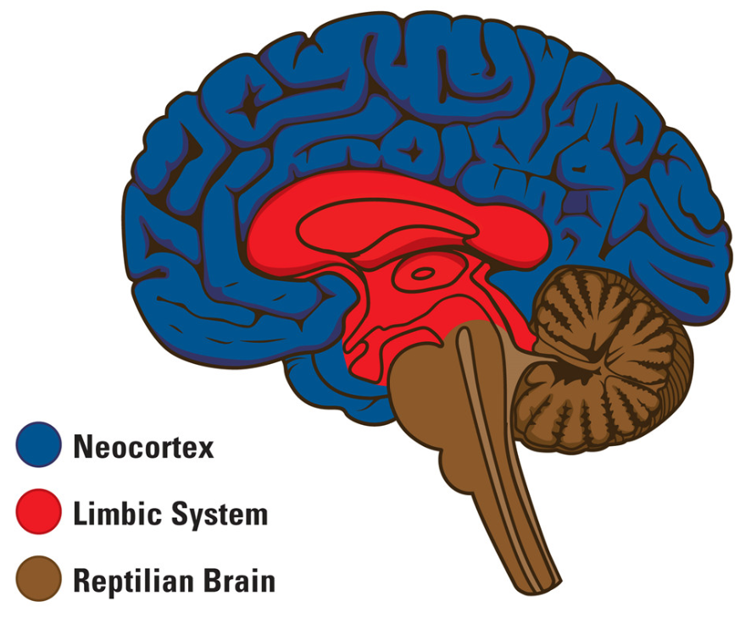
Signs of Stress Behaviour
Heightened Impulsivity
Difficulty Ignoring distractions
Mood Problems (Negatively)
Erratic Mood Swings
Trouble Listening
What they say doesn’t make sense
Notes:
Have you seen incidents of these types?
They are examples of when our Limbic Brain is activated, and over-riding our Pre-frontal Cortex.

Slide 15
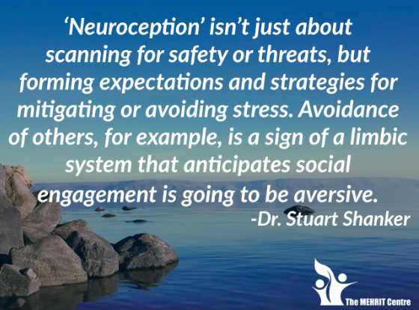
Notes:
It falls to those of us working in schools to be aware of our own stressors so that we too can help others regardless of their role and/or age become aware of their own stresses and strains.
That is Co-Regulation.
We all develop defense mechanisms as coping strategies. The best coping mechanism is understanding our own stress/energy levels… recognizing them and knowing when we either exert energy, or restore energy.
That is Self-Regulation.

Slide 16
https://self-reg.ca/wp-content/uploads/2020/06/2_8_Student_Reflection_Questions_V3.pdf
Notes:
One of the developing tools available to us through the MEHRIT Ctr. and self-reg.ca/resource-library/ is the questionnaire attached here in Appendix 2 to assist us in a co-regulatory role… is a guide to help focus our attention on those areas in which the children with whom we work may be experiencing stress.
Lets work through an example with a child in your care.

